Slide 1
Asking for moo-la
Joe, put your pants on dude!
Some insights into increasing your deal size

Slide 2
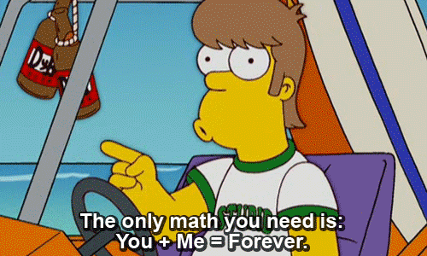
Easy solutions….math
Understand “their” math
Translate into ”digital math”

Slide 3
Look at companies that need $$$
Ad Group Sets:
Transmission Repair
Auto Repair Car Repair
Brake Repair
Branded
Average CPC:
$3.30
$3.66 $4.62
$5.01
$0.90
Daily Clicks:
$20/day budget
6 clicks
5 clicks
4 clicks
4 clicks
22 clicks
Conceptual Market Model: AAMCO of Utopia
Available Impressions for Transmissions: 70,000
Search Impression Share Goal: 85%
Revenue Goal: $10,000/Week
(Transmissions Only)
Rev Goal | Avg Ticket For Trans | How Many Cars Per Week
$10,000 | $1,666 | 6
Make it about math – so it’s simpler for them to quickly ”get”
Understand their cost structure – it’s OK to ask them
Auto repair
Average ticket is $1,600
Have 6 bays
Want to gross $20,000 per week
Your Lead Conversion Ratio | Actual Weekly Leads Needed to Hit Goal | Click to Lead Conversion | Transmission CPC Costs
50% | 12 | 30% | $3.30
Clicks Needed Per Day | Your True PPC Budget Needed to Hit Your Revenue Goal
8 | $750 Per Month

Slide 4
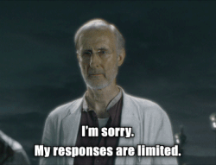
Easy solutions….ask questions
Disco
2 Ears, 1 Mouth – Best Sales Ratio to Ever Know
This is where deals are lost ---> Discovery
Close
Disco
Close
Notes:
Toss to Jen, AOE - Circle

Slide 5
What you don’t say
PURPOSE
CANDOR
TRUST

Slide 6
IN DISCOVERY, THERE ARE 6 routes to take
Business
Competition
Marketing
Digital
Events
New Times / V Digital Services

Slide 7
IN DISCOVERY, THERE ARE 9 POINTS
Jumping off point
Purpose
Critical Success Factors
Bus Driver
Processes
Talent Management
Service or Product
Strategy and Tactics
Brand

Slide 8
ANTICIPATE THE HARD STUFF
Write the questions down you don’t want to answer or have the answer to!
Find the answers…we have a ton of resources here!
Proactively share…we always share sales, but what about tips?

Slide 9
Step by step guide to a discovery call
DO YOUR HOMEWORK Zero in on what sparked willingness to speak with you, and review your lead tracking system for all related data. Spend ten minutes exploring their company website, community forums, and social media channels
FOCUS ON THEIR NEEDS Put the spotlight on your prospect’s issues and establish yourself as a valued resource to help them make the right decision when they’re ready to buy.
ASK UPFRONT QUESTIONS ABOUT BUYING ABILITY Get to the bottom of timeframe to purchase and decision-making while steering around budget allocation questions. If they need it, they’ll find a way to pay for it.

Slide 10
Step by step guide to a discovery call
SHARE 2-3 BENEFIT STATEMENTS Make a direct impact with 2-3 benefit statements relevant to your prospect’s pain points. Select specific topics based on what you’ve learned.
GET YOUR PROSPECT TO ELABORATE Enable dialogue, and avoid dominating with a presentation. Think two-way conversation, and ask, “why?” to learn the true meaning of their needs.
PROVIDE SOLUTIONS TO OBJECTIONS Know the difference between an objection and a question that’s a desire to learn more. Clarify issues and illustrate how your product or service will address their concerns.

Slide 11
Step by step guide to a discovery call
ESTABLISH UNDERSTANDING AND AGREEMENT Restate details of your prospect’s needs and understanding of how you help their business. Use notes jotted down during the call.
Create business metrics that allow measuring the time between sales stages. Generate customized pipeline reports based on discovery call criteria.

Slide 12
Some real life sales tips to share
Research 3-4 names of people in your prospect’s department on LinkedIn prior to your call.
Regularly rehearse up to twenty possible objections and handling tactics. Anticipate possible objections prior to each discovery session.
Let them do 80% of the talking. Favor listening over pitching.
Think “how,” instead of, “what,” in your delivery. List the steps in your process of working with clients to explain how your company helps customers.
Outline expectations, outcomes and a timeframe for moving forward in a concise Letter of Understanding (LOU) as a follow up message to your prospect.
For every statement they make, ask three questions to expand on the topic.
Directly ask questions like, “When are you looking to have these improvements in place?”

Slide 13
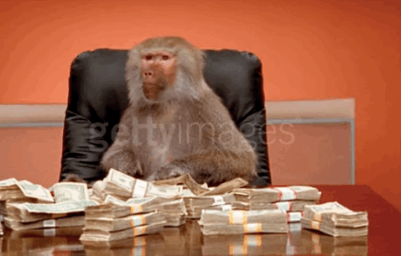
Who’s got questions?

